Slide 1
SUSTAINING
SOCIO-ECONOMIC VALUES OF LAKES: FINDINGS ON WATER CLARITY AND LAKESHORE
PROPERTIES
By Dr. Patrick Welle, Bemidji State Univ.

Slide 2
GROUPS WHO RECEIVE ECONOMIC BENEFITS
Lakeshore Property Owners
Residents who use lakes
Tourists
Non-Users who attach Stewardship Values to lakes

Slide 3
SELECTED EMPIRICAL FINDINGS
Citizens willing to pay mean values of $50-$200 per year to protect lakes from problems such as premature eutrophication, acidification, or deposition of mercury
Tourism parties spending average of nearly $1,000 per trip in northern MN, 75% stating environmental atrributes, lakes and forests as “thing they liked best.”
MPCA Impaired Lakes Study in Horseshoe Chain and Lake Margaret/Gull ($20 vs. $200 per year)

Slide 4
Lakeshore Property Values and Water Quality: Evidence from Property Sales in the Mississippi Headwaters Region
Charles Krysel, Elizabeth Marsh Boyer,
Charles Parson and Patrick Welle

Slide 5


Slide 6
Study Purposes:
To generate a high quality data set on sale prices of riparian properties in the MHB Region.
To find out how water clarity influences Minnesota lakeshore property prices compared to those in the state of Maine.
To estimate the implicit price of water clarity--- as an indicator of economic value.
To inform people about the connection between water quality, economic decisions and land uses.

Slide 7
Study Sample
37 Lakes
Lakeshore properties sold in 1996-2001
1205 properties included, out of 1350 visited.
Lakes assigned to six lake groups that best approximated market areas.

Slide 8
Data Collected
Property information obtained from county assessor records:
  Sales price, assessed values, tax rates
  Structural characteristics (square feet, # of stories, presence of fireplace, central heating, full bathroom, garage, etc.)
  Property characteristics (lot size, frontage feet, public road, adjacent density, etc.)

Slide 9
Environmental Variables
Lake Water Quality
  Mean water clarity measurement (Secchi disc reading) on the lake for the year property sold
Site Quality
  Rating assigned to each property based on 8 site quality factors such as view, kind of shoreline landscaping, density, vegetative cover

Slide 13
Mean Values by Lake Group
Property Price
Price per Front Foot
Water Clarity
Aitkin
$100,313
$452
2.78
Brainerd
$176,461
$959
3.99
Grand Rapids
$135,905
$434
3.82
Walker
$179,621
$720
4.29
Park Rapids
$124,390
$458
4.19
Bemidji
$142,829
$624
2.85

Slide 14
Procedure
The econometric valuation technique called “the hedonic property value model” was used to reveal the portion of purchase price attributed to water clarity, a “non market” environmental quality amenity.
Hedonic models use multiple regression analysis
Separate model equations were estimated for each of the six lake groups
PPLandFF = f (S, L, lnWQ*LA)

Slide 15
Major Findings
Water clarity is significant in each of the six lake groups---a positive relationship.
Robust results in that the positive influence of water clarity on property values is highly significant in alternative forms of the model.

Slide 16
Major Findings
Site quality is significant in four of the lake groups---three had negative relationships and one was positive.
I.E. More damaging lakeshore practices increased sale prices.

Slide 17
Implicit Price of Water Clarity
Price change per frontage foot for a one (1) meter change ,+or-, in water clarity for selected lakes multiplied by the marketable shoreline length
Gull Lake: (+) = $39FF, $6,500,000 Lake (-) = $53FF, $8,800,000 Lake
Pokegama: (+) = $30FF, $5,000,000 Lake (-) = $36FF, $6,000,000 Lake
FishHook: (+) = $61FF, $1,900,000 Lake (-) = $83FF, $2,600,000 Lake
Big Turtle: (+) = $21FF, $1,000,000 Lake (-) = $29FF, $1,400,000 Lake
Big Sandy: (+) = $218FF, $63,579,983 Lake
(-) = $516FF, $150,560,122 Lake

Slide 18
Site Visits to Assess
Shoreland Quality and Property Prices
Fine Lawns versus Fine Lakes:
High Priced Land
High Risk Lakes

Slide 19
Over 1,350 individual site visits
Possible in one summer thanks to recent developments in geographic information at the county level.
Using E911 locations in some counties.
Creating our own GIS data in two counties from assessor’s maps.
  Scanning, rectifying, and counting lots from landmarks

Slide 20
Sources of GIS Support
Eight counties assisted in this project to the best of their abilities. Three, Cass, Aitken and Hubbard had complete parcel mapping for area that we needed. Two others, Crow Wing and Itasca were in the process, and Itasca actually diverted surveyors to complete lakeshore parcels that we needed. Beltrami had lakes outside Bemidji parcel mapped, but not within the city. Morrison had E911 mapping for us to draw on, and Clearwater provided us an assessor’s map which we rectified as best we could.

Slide 22
Lakes and Water Clarity
Although there is a product available in a GIS format, we drew our data from Mn.PCA so that we could relate clarity in the year that a parcel was sold to its price.

Slide 23
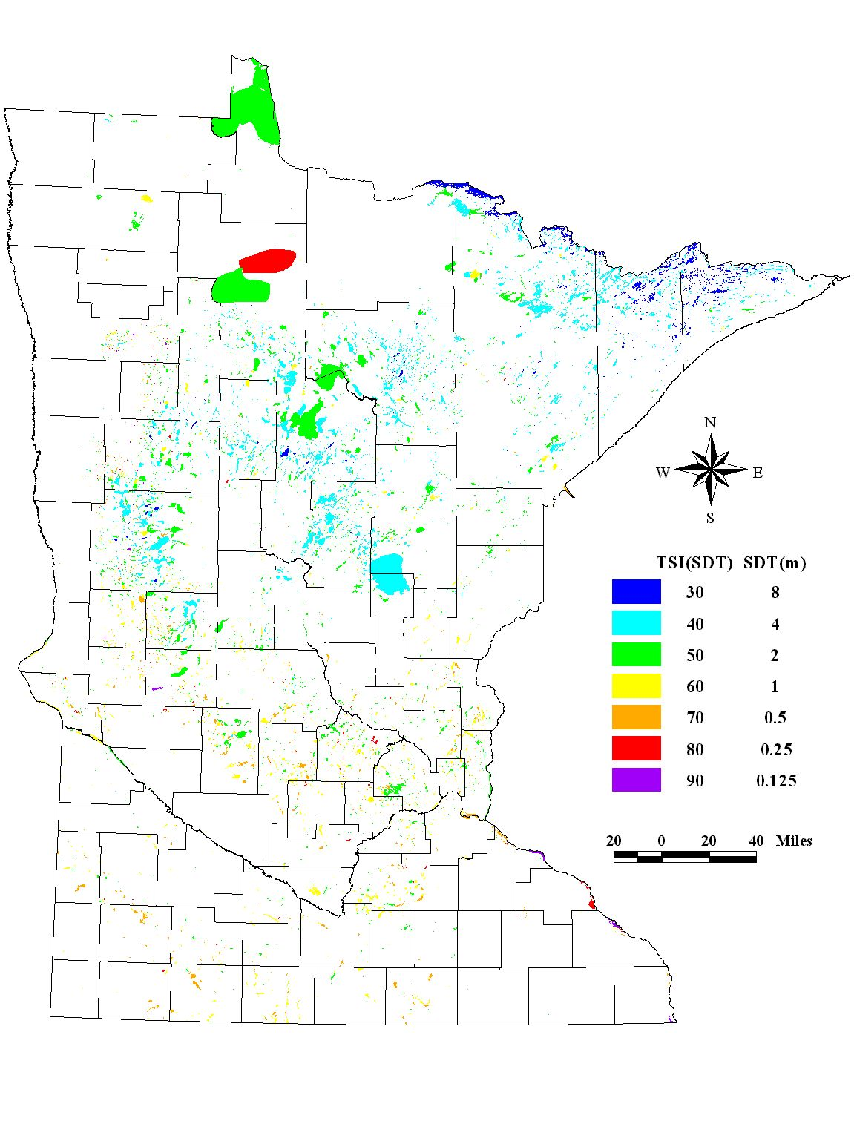
Minnesota “Land of 10,000 Lakes”
Figure from: University of Minnesota Remote Sensing Laboratory

Slide 24
Shoreland Quality Indicators
View from the parcel (Pristine 3, Some Development 2, Heavily Developed 1)
Shore Landscaping (Deep Indigenous Buffer 4,Deep Buffer>15’ 3, Thin Buffer 2, Mowed to Water 1)
Texture of Riparian Bank (Naturally Rocky 4, Sand 3, Mud 2, RipRap 1)

Slide 25
Remotely Sensed Water Clarity
The other draw back to using the statewide map was precision.
As we developed a linear model, we needed clarity data in tenths of meters to correlate with prices in actual dollars.

Slide 26
Shoreland Quality Indicators
Parcel Ground Cover (Brush 3, Grassland 2, Mowed Lawn 1)
Tree Cover (Coniferous 4, Deciduous 3, Mixed 2, Nothing 1)
Vegetation in Riparian Zone (Wooded 5, Emergent 4, Submergent 3, Nothing 2, Artificially Cleared 1)
Tree Frequency (Many 3, Several 2, Few 1)
Built Shore Structures (None 4, Dock 3, Boat Lift(s) 2, Boat House etc. 1)

Slide 27
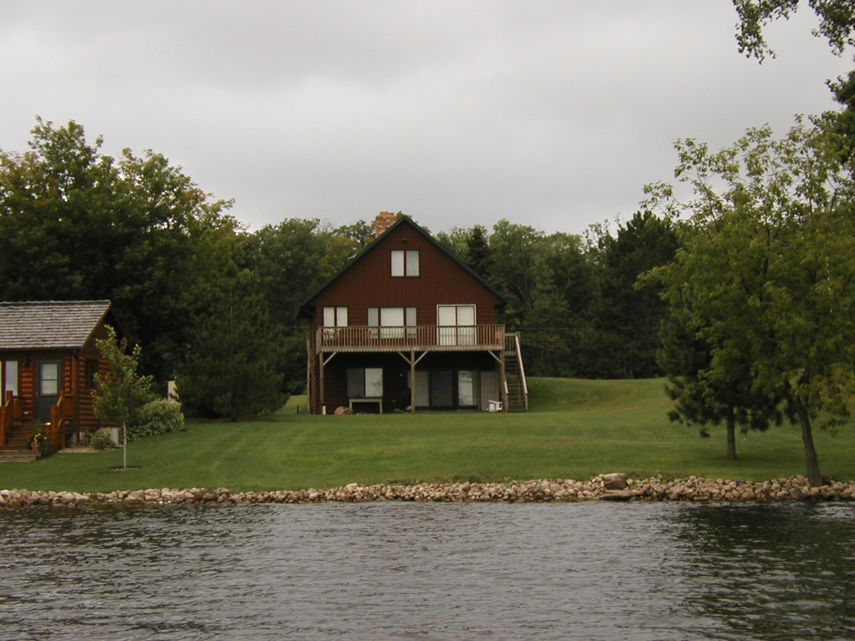

Slide 28
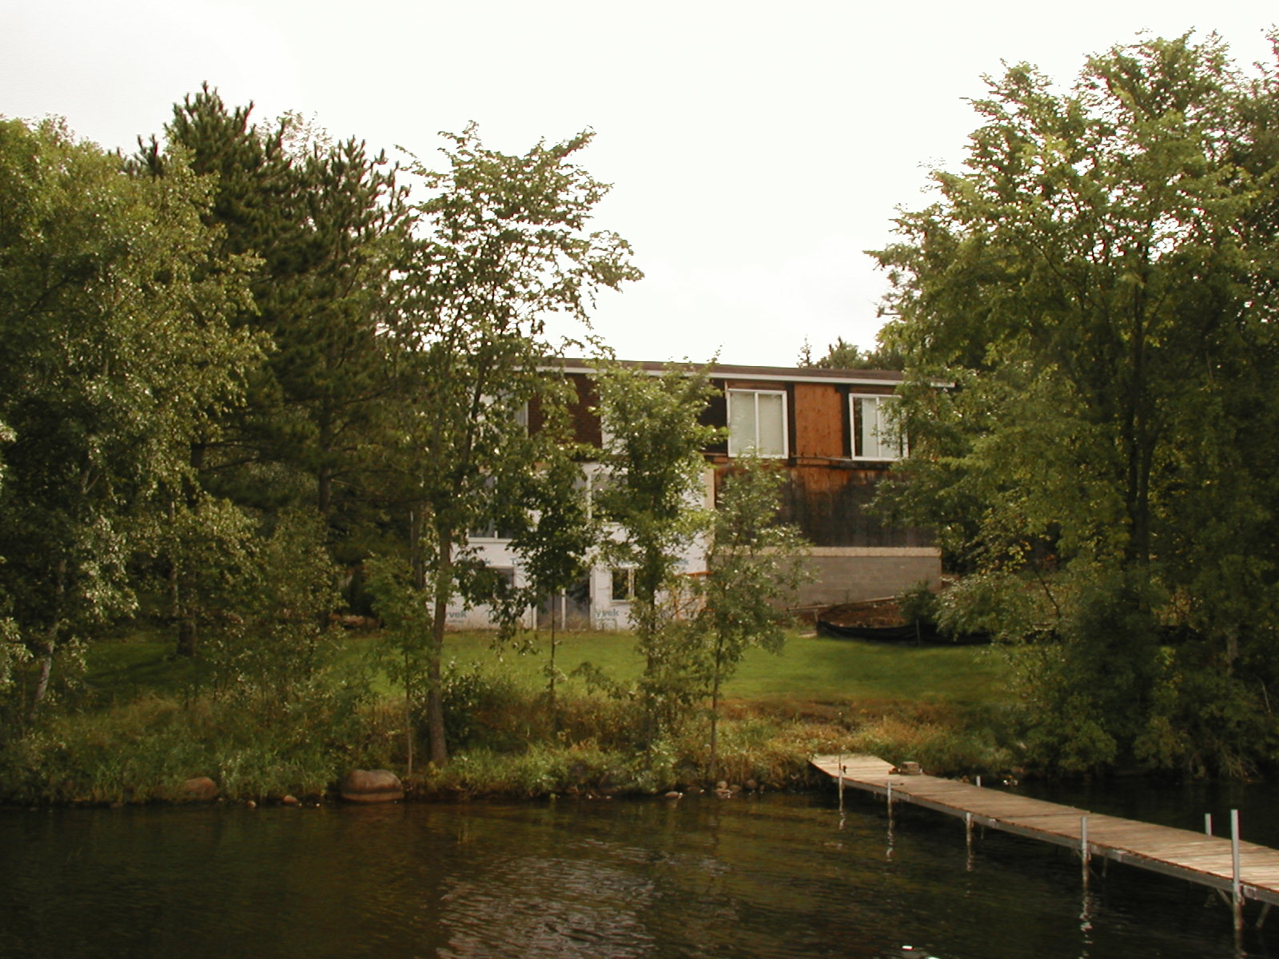

Slide 29
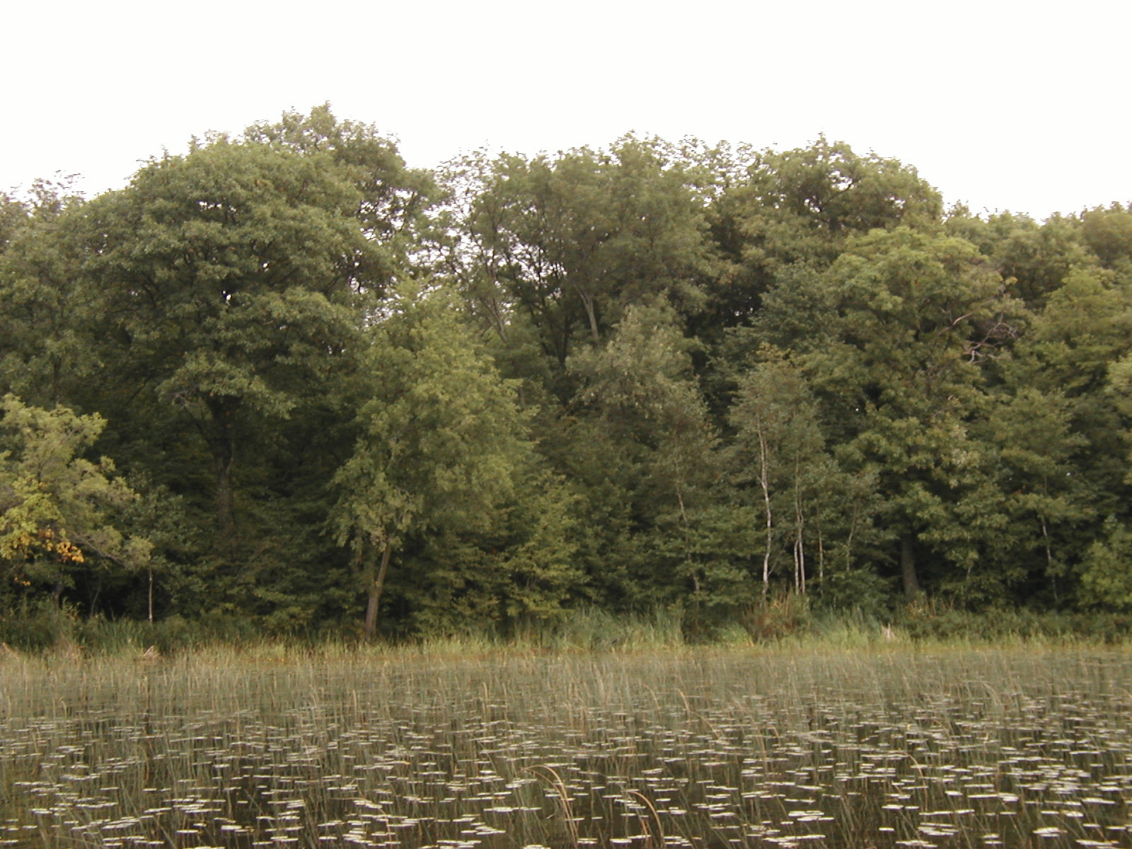

Slide 30
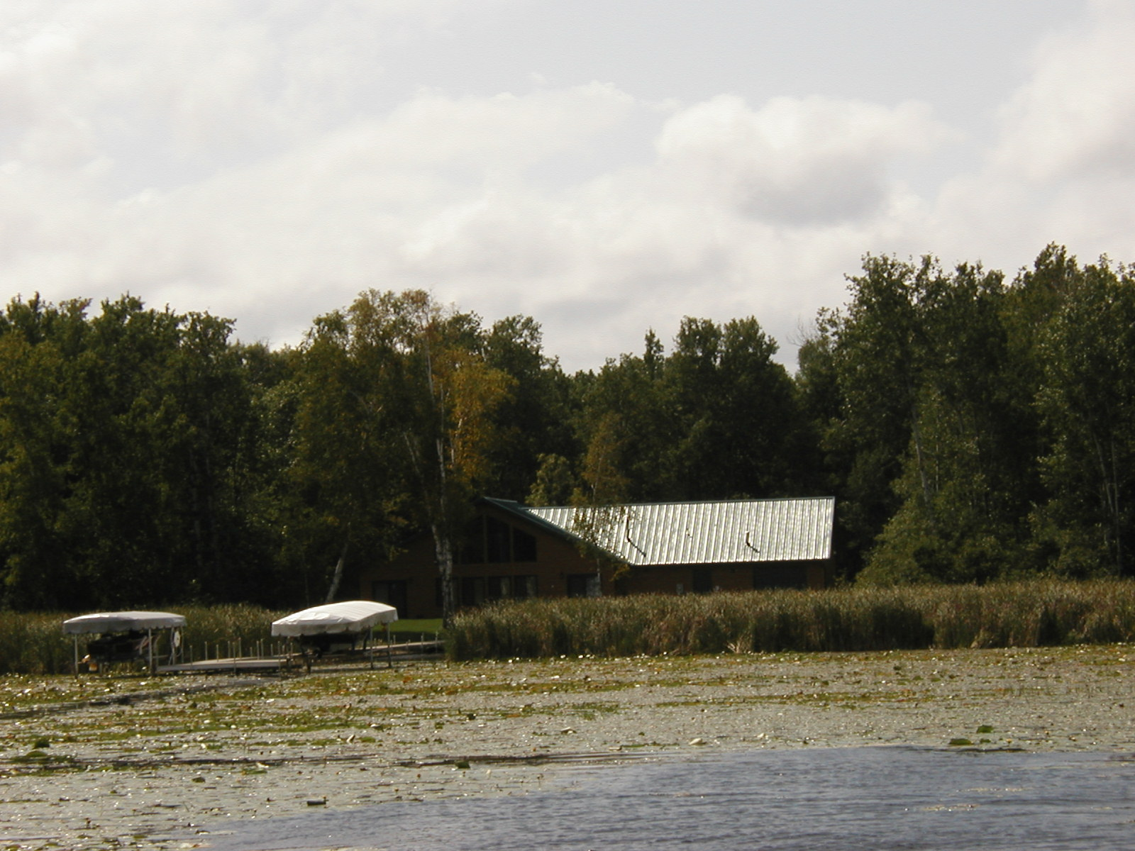

Slide 31
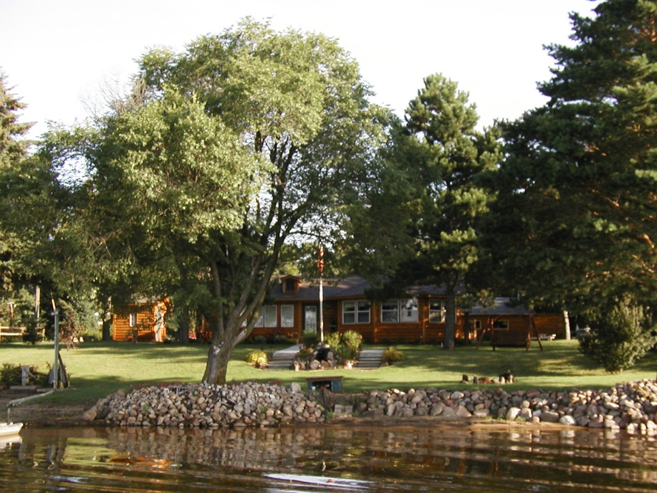
Relationships between lakeshore management and price (negative)
In the “prestige” lake areas properties like this bring the highest prices.
Unfortunately, they are also likely to degrade lake clarity

Slide 32
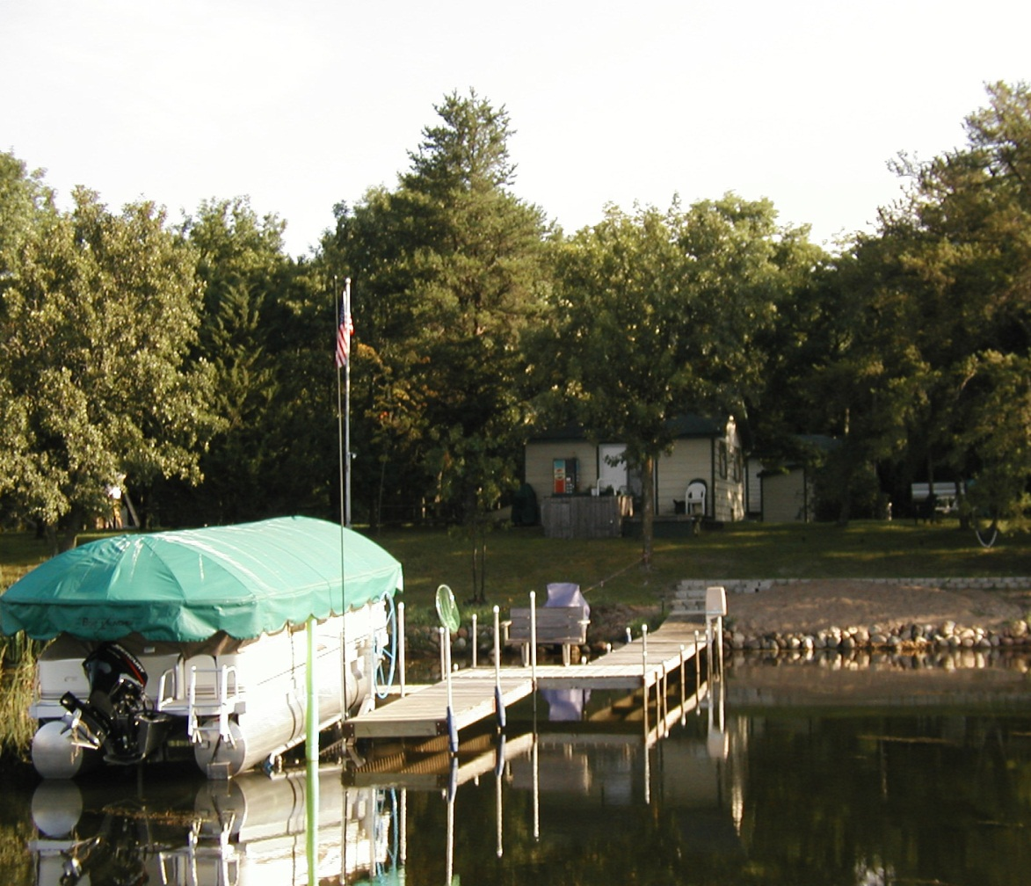
Relationship between “prestige” lakeshore and water quality
Fertilizer enters the lake
Sediment laden runoff
Wave erosion
Turbulence from water craft “on the beach”
Lack of shaded water
All potentially damage clarity.

Slide 33
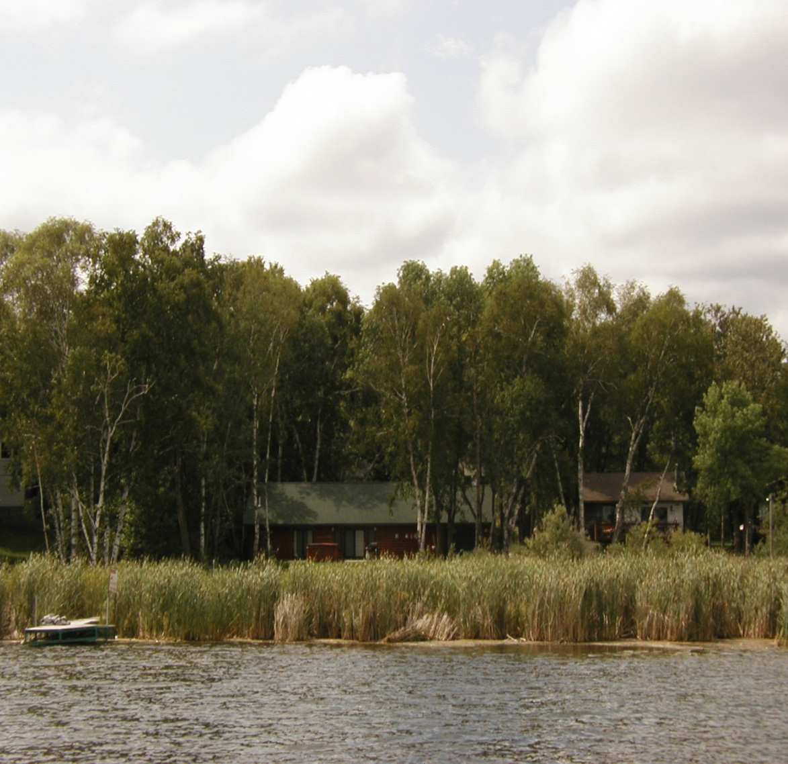
Relationship between lakeshore and price (positive)
In the less developed market area environmentally desirable practices are associated with higher property prices

Slide 34
Desirable Lakeshore Practices
Maintain a dense vegetated buffer between the lake and the lawn.
Leave or re-plant aquatic vegetation.
Terrace slopes and leave them wooded.
Shade the lake if possible.
Minimize structures in the lake to limit stirring up the lakebed.

Slide 35
The public good
Policy makers may use incentives or disincentives to change lakeshore management.
Tax bases may increase as lakeshore management improves by millions of dollars in every county.

Slide 36
The Bottom Line
A one meter clarity change on 3,700 lakes in Minnesota (about 1/3 of our total) may cause a $100,000,000,000 property value change.
At present the overall lakeshore property values are endangered by the actions of property owners who wish to maximize their personal gains.
Fine lawns can foul lakes. We need better incentives and education to encourage more lake-friendly practices to protect our “10,000 lakes”.

Slide 37
LCMR , MHB and NSF supported this research
Patrick Welle, Ph.D.
Professor of Economics & Environmental Studies
Bemidji State University
PWelle@bemidjistate.edu

Slide 38

ftp://ftp-fc.sc.egov.usda.gov/Economics/recreate/lakestudy.pdf
The report as a 58 page pdf file may be downloaded here.

